Slide 1
Welcome to SAP MM training Session 3
MASTER DATA
Trainer: NGWA HENRY NGWA I Phone: +1(571)-969-8016
Email: info@studysapnow.com I Website: www.studySAPnow.com
Trainer: NGWA HENRY NGWA I Phone: +237 67510 4631
Email: ngwahenry2@gmail.com I Website: www.sapbizsolutions.com

Slide 2
Master Data Topics
Types of users in SAP
Types of SAP data
Significance of Master data
Create/Change/Display Master Data
Copy Master Data
Vendor Master Data
Material Master Data
Entry aids for Material Master
Collective Entry for Storage Location

Slide 3
Types of users in SAP
End users
Super/Power users
SAP Consultants

Slide 4
Types of SAP Data
Master data (Vendor, material, etc.)
Transaction data (Purchase order, sales order, invoice)
Customizing data

Slide 5


Why do we need Master data?
Significance of Master Data
Purchase Order
Items
10 __________
20 ________
25 _________
Vendor Master record
Material Master record
Purchasing Info record

Slide 6
VENDOR MASTER DATA

Slide 7



Vendor Master Data
General Data
Address, communication, control data, bank details.
Company code data
Account management, payment transactions, correspondence, withholding tax.
Vendor Master record
Purchasing Organization data
Purchasing data, partner roles.
Transaction codes
XKO1 (Create)
XKO2 (Change)
XK03 (Display)

Slide 8
Vendor Master data Org. levels
Transaction codes
MK01 (Create)
MK02 (Change)
MK03 (Display)
General data
Purchasing and accounting data can be maintained centrally or independently of each other
Company code data
Purchasing Org. data

Slide 9
Account Group
Status( Vendor or one time vendor)
Number interval
Field selection
The Account Group
Type of number assignment
Partner schema
Vendor sub-range or plant specific data

Slide 10





One Time Vendor
Vendor Master Record
Description
Language
Reconciliation Acct
Currency
stationaries
MSK Ltd
RFQ/PO
________ _________
_________
Electrician
Invoice Verification
plumber

Slide 11

Reconciliation Account for Vendor Master
R/3 System
Enter vendor invoice
Sub ledger accounting
Financial Accounting
Vendor A
Reconciliation account
Total liabilities per vendor
Total liabilities for all vendor

Slide 12




Partner Roles
Order recipient
Invoicing party
Vendor
Supplier of goods
Payee

Slide 13
Creating Vendor via Reference
Reference
Address data
Control data
Copy
Control data
Blank

Slide 14

How to Block Vendor
MSK LTD
Transaction Codes
XK05 (Block)
XK06 (Delete)

Slide 15
Assignment (Vendors)
Create new vendor using transaction code XK01. Use Account group KRED and Reconciliation account 31000. Use Porg 1000 and Cocode 1000.
Open the above created vendor using transaction code XK02 and see the different partner roles
View the same vendor using transaction MK02. What difference did you notice?
Also create a on time vendor using Account group CPD and check if you have to maintain fewer fields than with account group KRED.
How would you block a vendor?
How would you delete a vendor?
NB: Read chapter 3.2 of your text book to prepare for the next lesson.

Slide 16

Thank you for watching

Slide 17
MATERIAL MASTER DATA

Slide 18











Material Master
Basic data
Purchasing
Material Planning
Sales & Dist.
Stocks in plant/ storage location
Work scheduling
Accounting
Material Master record
Quality Mgt.
Storage
Forecasting
Ware house Management
Classification

Slide 19

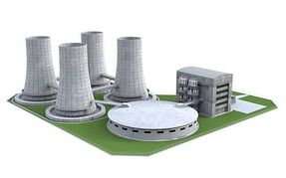
Material Master Org. Levels
Data that is valid for the whole company
e.g. material number, material short text, material group, base and alternative units of measure.
Data that is valid within one plant
e.g. purchasing data, MRP data, forecasting data, work scheduling data
Data that is valid for one storage location
e.g. storage bin description, picking area

Slide 20
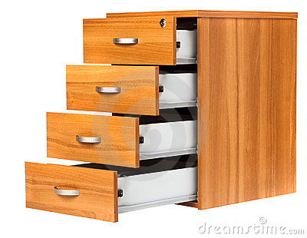
Material Type
Number Assignment
Raw
Procurement Type
Materials
Operating
User Departments
Suppliers
Control
Field Selection
Semi-finished
Products
Account Determination
Finished
………………..
Products

Slide 21
Industrial Sector
Chemical industry
Plant eng/ construction
Mechanical Engineering
Screen Selection
Control
Field Selection
Transaction codes
MM01 (Create)
MM02 (Change)
MM03 (Display)

Slide 22
Extending Material Master
Accounting Plant 1000
Purchasing Plant 1200
Accounting Plant 1200
Extend with
Create
Create
Material 4711
Material 4711
Material 4711
Purchasing Plant 1000
Purchasing Plant 1000
Purchasing Plant 1200
Accounting Plant 1000
Accounting Plant 1200
Purchasing Plant 1200
Accounting Plant 1200

Slide 23
ENTRY AIDS FOR MATERIAL MASTER

Slide 24



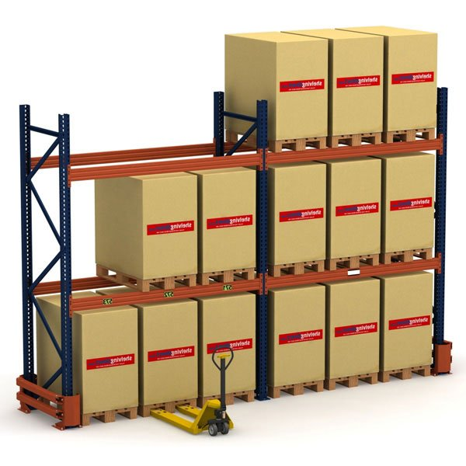

Entry Aids for Material Master
Default Settings
Material Master Maintenance
Reference Material
Collective entry of storage location data
(MMSC)
Mass Maintenance
(MM17)

Slide 25
Assignment
Create a new Material Master record using transaction MM01 (use material type ROH & plant 1000. Use same industry sector, St. loc, sales org as per the video)
Search the above created material using transaction MM02 and observe the different tabs and the type of data that can be stored in those tabs.
Extend your newly created material to the below storage locations using the transaction code MMSC to SL. 0002, 0003 and 0004.
NB: Read chapter 4.2 & 4.3 of your text book to prepare for the next lesson.

Slide 26
Thank you for watching

Slide 27
Purchasing Info Record

Slide 28
Business Example
You often procure material from the same vendor at a given price and condition
You would like to create a purchasing information record as source in the system and this PIR will be used as a reference for all future purchase orders

Slide 29
Purchasing Info Record
Material Master record
Info record 5301
Vendor
Material
Purchase org.
----------------------------------------------------------------------
Material group planned delivery time
Order quantity Minimum quantity
Gross price Info order text
Discount
1000
M-01
1000
Vendor master record
General Data
Purchasing Data
0001
10
Quotation
PC
100
Outline agreement
Conditions
Texts
Purchase Order
_____________________
1200 EUR
5 %
Packed individually

Slide 30




Purchasing Info Structure
General Data
Vendor data(reminder data, vendor’s material number)
Origin data
Order unit (conversation)
Internal info record memo
Administrative data
Purchasing Org. data
Control (delivery time, minimum quantity…)
Prices & conditions (gross price, discount, freight….)
Statistics (Price history, PO statistics…)
Texts (purchase order text….)
Purchasing Info record
Purchasing Org/ Plant data
Control (delivery time, minimum quantity….)
Prices & Conditions (gross price, discount, freight….)
Statistics (price history, PO statistics….)
Texts (purchase order text…..)

Slide 31

Info Records and Prices
Create PO item
YES
Does info record exist?
NO
Info record
Valid conditions
price/ UoM freight
50 EUR/pc 2%
NO
YES
Last purchase order
4500006398/10
PO price:
Manually entered price
PO price:
Info record conditions
PO price:
Conditions of last PO

Slide 32

Info records Manual update
MANUAL
Quotation
________ _________
_________
Info record
5300000816
Vendor: 1234
Material: A21
Purchase order
________ _________
_________
Purch. Org: 3000
Conditions
Outline Agreement
________ _________
_________
Priice/UoM: 6UNI/kg
Freight: 2%
Discount: 4%
Last purchase order
4500006398

Slide 33
Info records Automatic update
Quotation
No. 6000014
Info record
5300000816
1 pc M-10= 500 UNI
Discount 4%
Vendor: 1234
Info update
Material: M-10
Purch. Org: 1000
Purchase order
No. 4500006398
Conditions
Priice/UoM: UNI 500/pc
1 pc M-10= 500 UNI
Discount: 4%
Info update
Last purchase order
4500006398

Slide 34
Default Pricing in Purchase Orders
Purchase Order
_____________________
Info Record
Vendor 123
Material ABC
Purchase org. 1000
-------------------------------
Price 10.00
PO text
……
Purchase Order
Vendor 123
Material ABC
Purchase org. 1000
Plant XXX
-------------------------------
Price 10.00
PO text
……
Material
Purchasing data
PC
%
Condition
$
Info Record
Vendor 123
Material ABC
Purchase org. 1000
Plant 1000
-------------------------------
Price 9.00
PO text
……
Purchase Order
Vendor 123
Material ABC
Purchase org. 1000
Plant 1000
-------------------------------
Price 9.00

Slide 35
PIR for Material Group
Material group: Office
Short Text: Notepad, white pad
Sort String: Pad
Price: 2.50
PO text: Notepad, size A4, recycling papers white, 50-leaf
Info Record
Vendor 123
Material ABC
Purchase org. 1000
-------------------------------
Price 10.00
PO text
……
Optimized purchasing

Slide 36
Price Change for PIRs
Price Increase
Gross Price
5%
Info records before
S-01 Steel-1
Gross price: EUR 100
S-02 steel-2
Gross price: EUR 120
Info records after
S-01 Steel-1
Gross price: EUR 105
S-02 steel-2
Gross price: EUR 126
Logistic ➔ Material management ➔ Purchasing
Master data ➔ Conditions ➔ Vendor Price Change ➔ Changes Involving Info Records (MEKP)

Slide 37

What have we ordered from this vendor in recent times?
How good is the vendor?
Buyers Negotiation Sheet
What materials can the vendor deliver?
General Conditions
Evaluations
Info Records
Terms of delivery
Payment terms
01. Price
02. Quality
03. Delivery
……..
M-01: EUR 180
M-02: EUR 150
…….
87
89
91
Logistic ➔ Material management ➔ Purchasing
Master data ➔ Conditions ➔ Info record ➔ Buyer’s negotiation sheet ➔ By vendor (ME1X) / By material (ME1Y)

Slide 38
Assignment 1
Create a new PIR record for your vendor and material without plant (Use the vendor and material you created in the previous topics. Also add PO text as “freight prepaid delivery” and save it.
Create new purchase order for the same vendor and material and check if system adopted the PIR automatically
How can you change the condition (price) for your PIR?
If the vendor asked for 3% price increase for all materials supplied by them, starting 1st of next month, how would you implement this in the system? (Please upload all screenshots)

Slide 39
Assignment 2
Create a PIR for material group 50001. Use purchase Org. 1000, and plant 1000. Maintain planned delivery time – 5 days and price – 10 USD/pc
Create a new purchase order with short text “spare parts” using account assignment category as “K”. Also use cost center 40,000 and G/L act 400,0000. Manually select your PIR record for this purchase order and observe the data (like planned delivery time, price, etc.) picked up from your PIR

Slide 40
Thank you for watching

